Slide 1
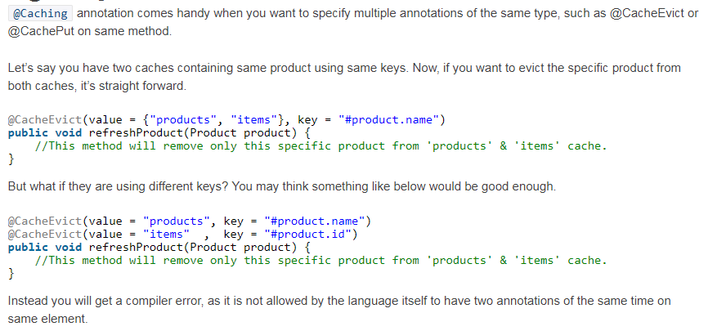

@Caching Annotation

